Slide 1
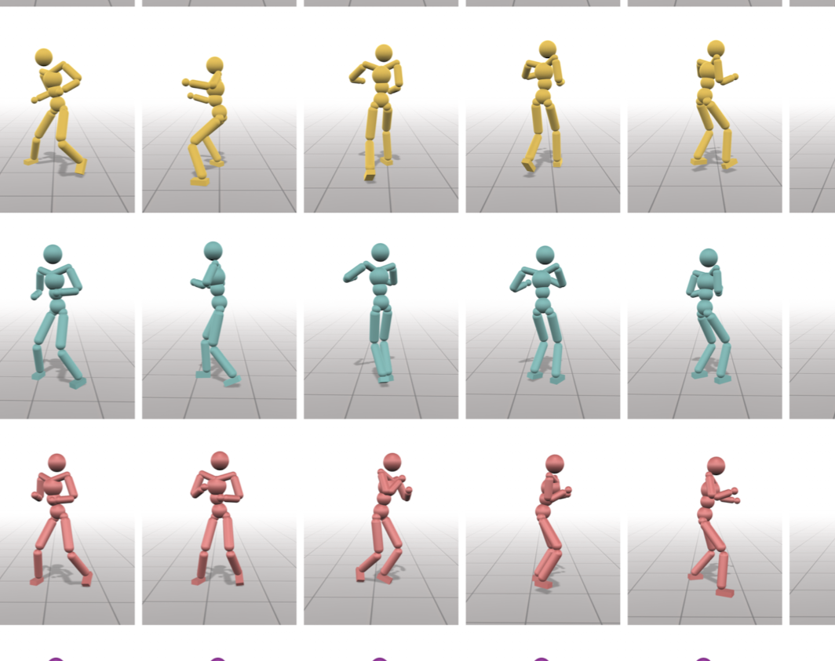
Learning and Exploring Motor Skills with Spacetime Bounds (2021)
Notes:
"Today, we're delving into a fascinating area of AI: teaching machines to learn and explore motor skills."
"We'll discuss a groundbreaking paper that introduces a novel approach using spacetime bounds."

Slide 2
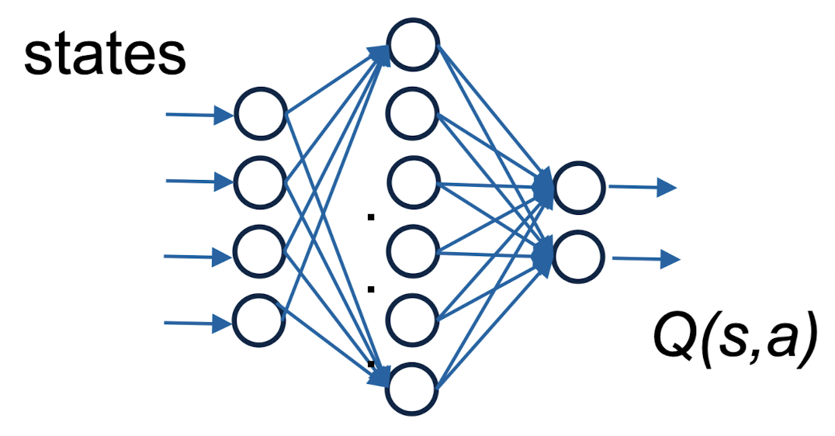
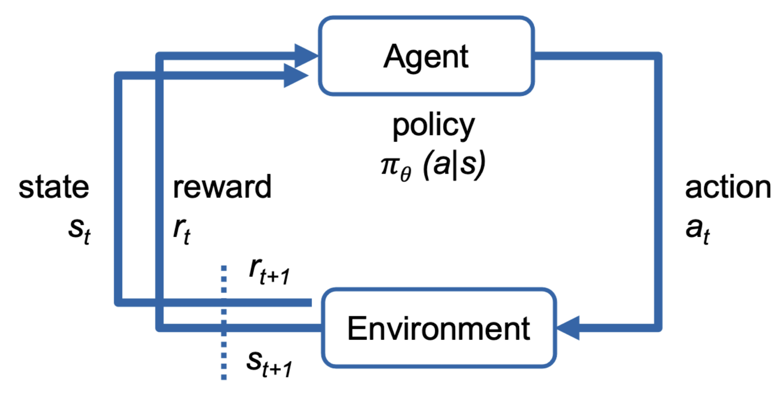
Understanding Deep Reinforcement Learning
Notes:
"At its core, DRL involves teaching a machine to make decisions through trial and error, aiming for a specific goal."
"It combines deep learning (like neural networks) and reinforcement learning (where actions are rewarded)."

Slide 3
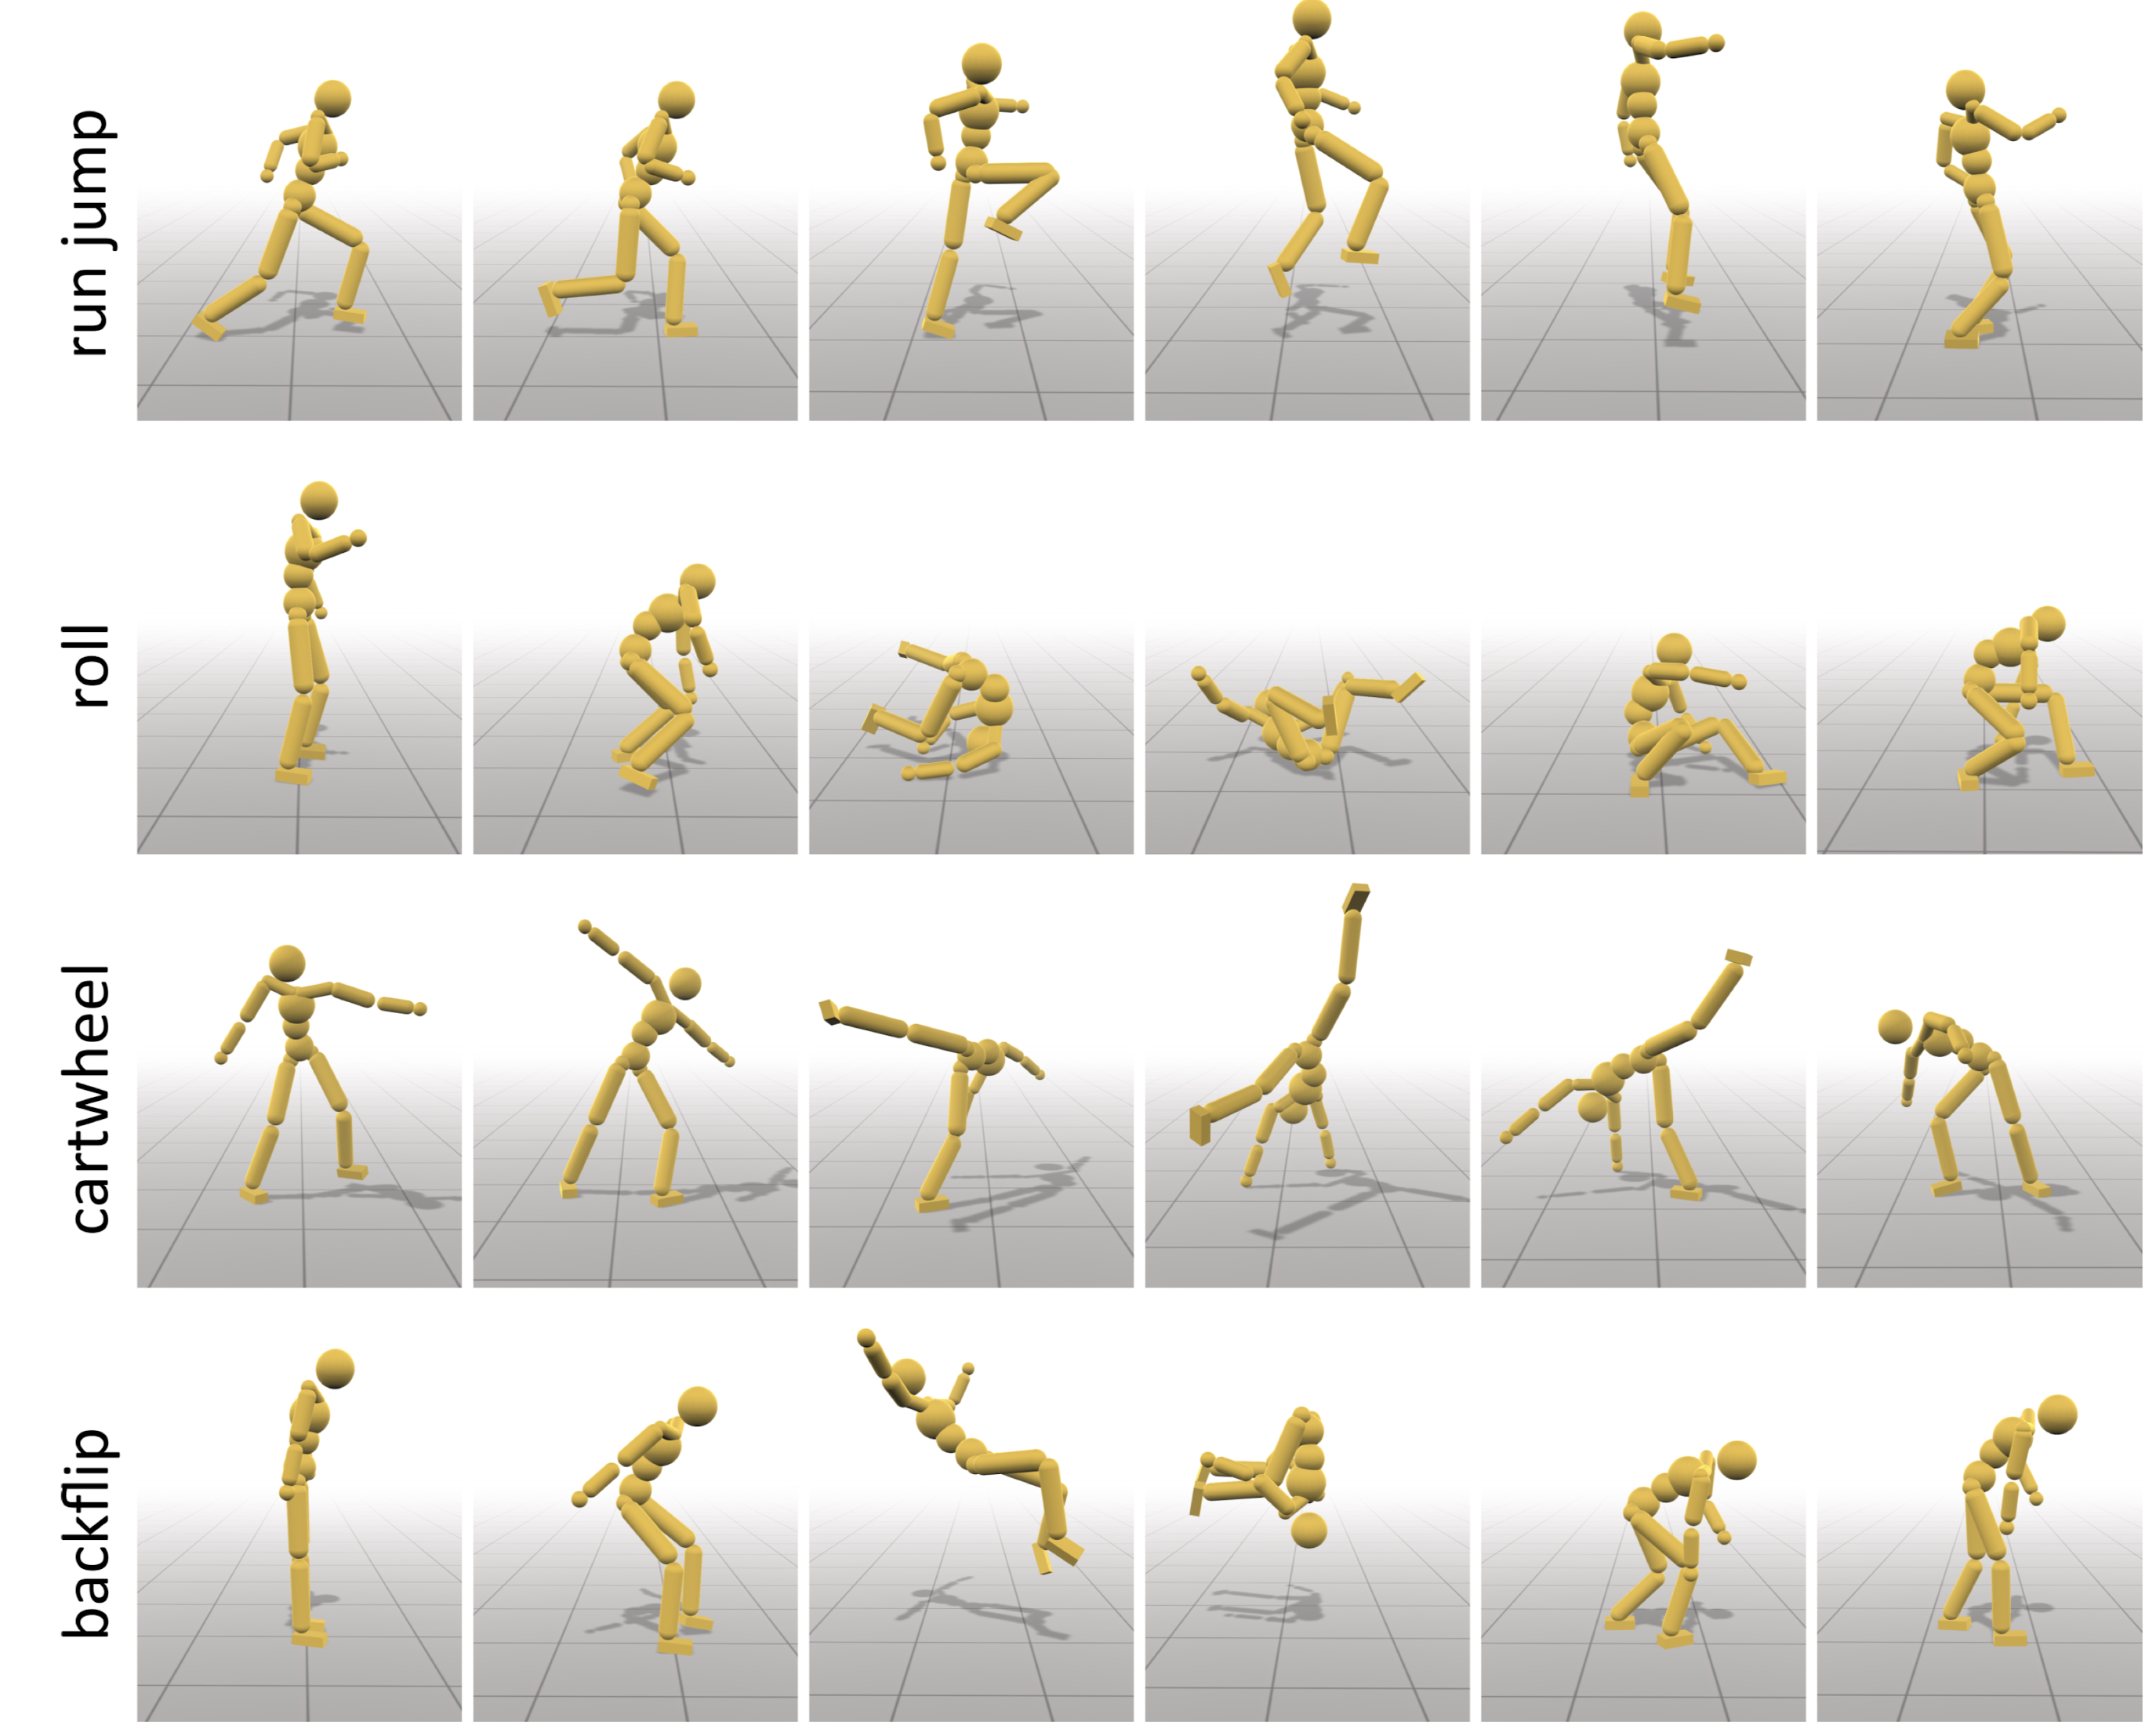
The Role of Motor Skills in AI and Robotics
Perform complex physical tasks
Applications in robotics, gaming, animations
Notes:
"Motor skills in AI refer to the ability of robots or virtual agents to perform complex physical tasks.”
"These skills are crucial for applications in robotics, gaming, and animation."

Slide 4
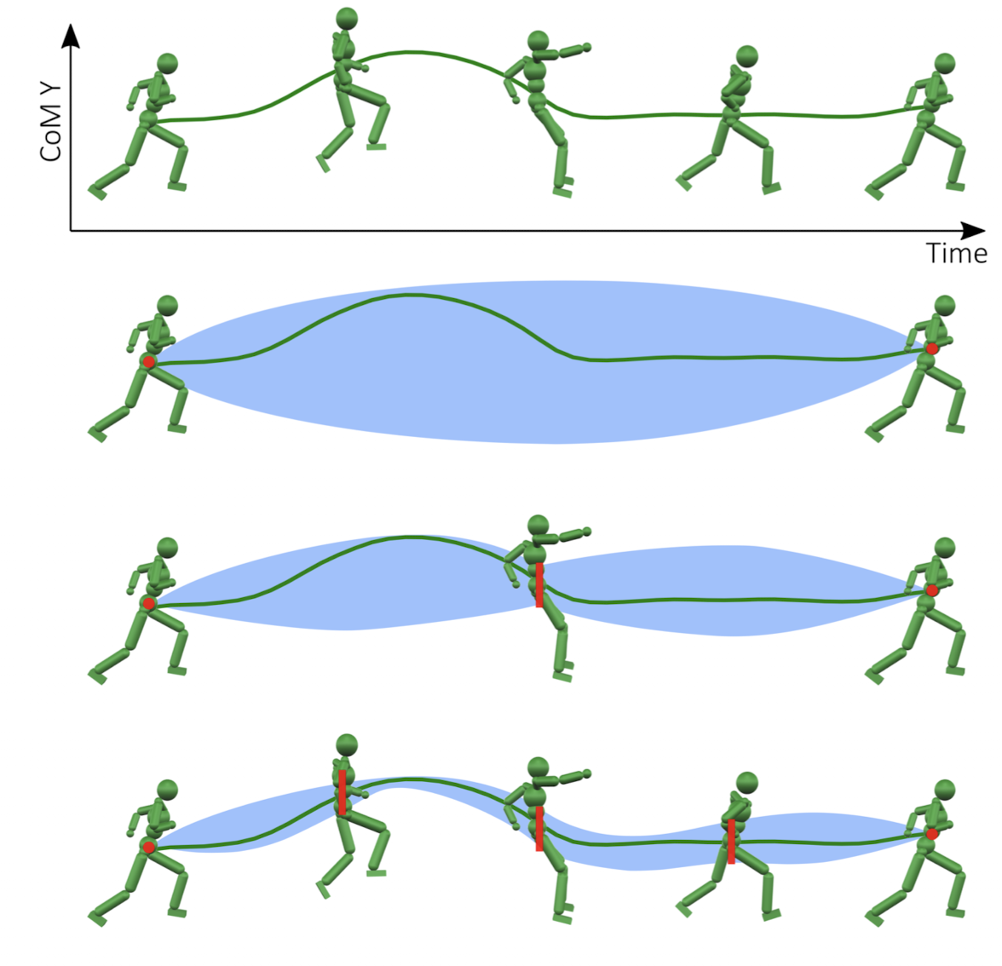
Objective of the Paper
Introduces a new method for teaching motor skills using spacetime bounds
Notes:
"This paper introduces a new method for teaching AI agents motor skills using spacetime bounds."
"It addresses the challenge of learning from imperfect or varied motion data.”
Reference is only keyframes

Slide 5
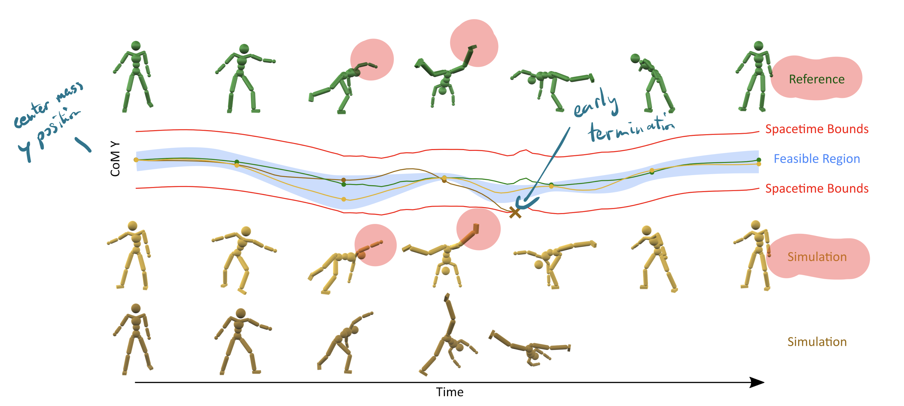
Key Concepts: Spacetime Bounds & CoM Positions
Notes:
Spacetime Bounds: Constraints in both space and time for guiding the learning process."
"COM (Center of Mass) Positions: Tracking the AI agent's balance and posture during movement."

Slide 6
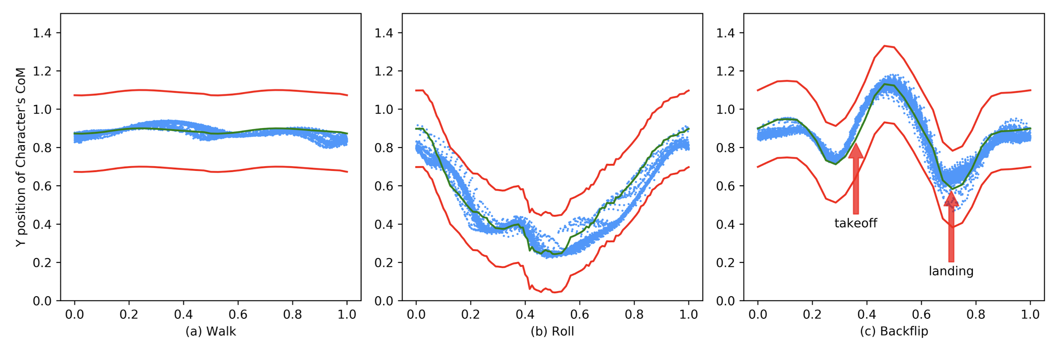
Approach and Methodology
Model weight: 45kg
15 internal joints with 34 Degrees of Freedom
Total reward = binary survival reward * other rewards
Training takes 30 min to 24 hours
Notes:
The study uses a combination of DRL and spacetime constraints."
"The AI agent learns by comparing its actions to a set of predefined spacetime bounds.”
Figure: blue dots samples from 100 episodes of the learned policy // narrow around takeoff and wider on landing
Binary survival reward
Early termination using spacetime bounds
Rewards combinated with other rewards
Training takes between 30 minutes to 24 hours

Slide 7
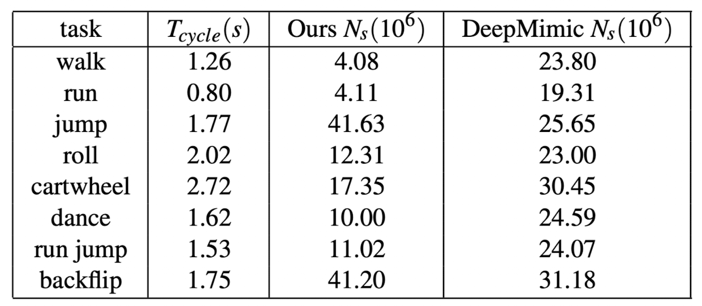
Results of the Study
Improved efficiency in learning complex motor skills, i.e. 360° jump turn in a break dance
Effective for dynamic movements, like cartwheels, due to better handling of spacetime constraints
Effective for style exploration
Notes:
N_s = training samples needed for character to be able to perform tasks for 20 seconds without falling
T_cycle(s) indicating how long it takes for the character to complete one full repetition of the motion. For example, a walk might have a cycle time of 1.26 seconds, meaning it takes that long for the character to complete one full walking cycle
DeepMimic aims to train physics-based character models to perform complex, human-like motions with high fidelity. This is achieved by imitating real-world human motion data

Slide 8
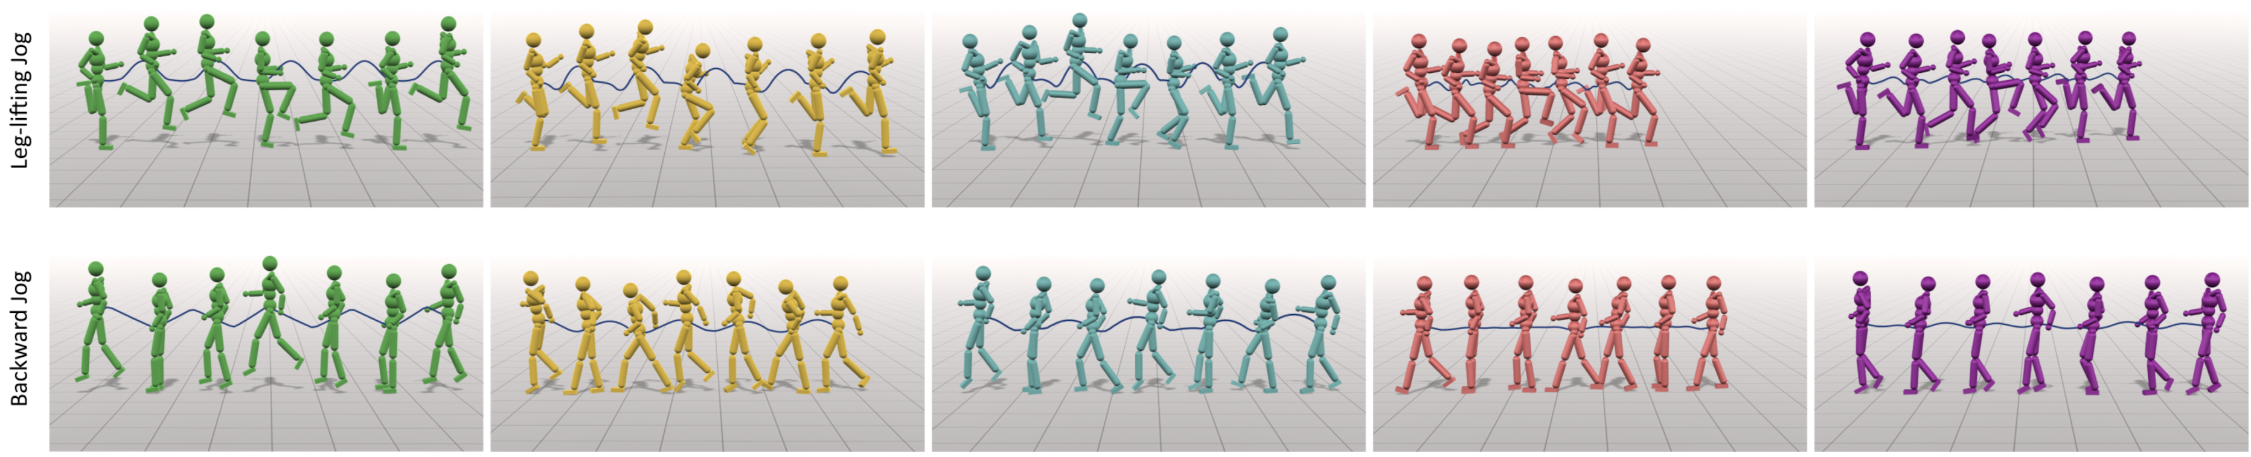
Results of the Study
Reference bound reward bound + imitation imitation DeepMimic

Slide 9
Concluding Thoughts
Robust motor skill learning without any imitation or handcrafted rewards
Good for low quality reference motions
Impose constraint on the training process
Can be easily combined with style exploration, imitation reward, …
Minimal tuning
Notes:
Tight bounds: good quality reference, when need to reproduce reference
Loose bounds: bad reference, explore different styles
Not matter: for gymnastic backflip because highly constrained
Put early termination techniques such as undesired body ground contacts.

Slide 10

Questions & Answers
Thank you for your attention

